Slide 1
DeepFakes
Innovation
21/09/2024

Slide 2
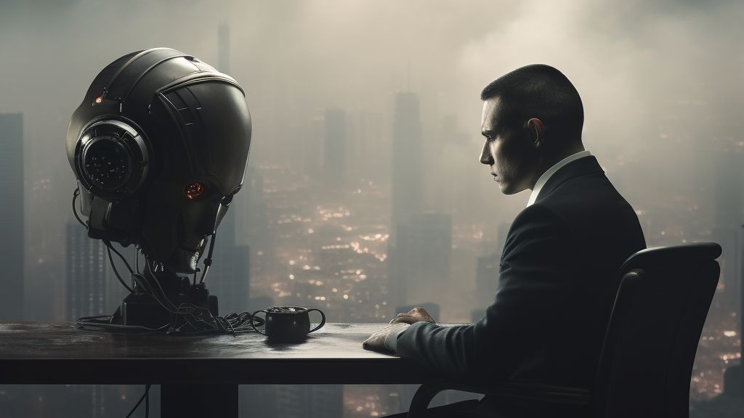
The AI Podcast

Slide 3


Model Architecture
Dialogue
Speech
Microphone
Prompt Audio
GPT
Speech to Text conversion
Text Question to Text Answer
Audio Answer
Podcaster
11Labs
Cloned Audio
Guest
Asynchronous Conversation on Google Colab Nvidia Tesla T4
Camera
Image
SadTalker
Picture
Stable Diffusion
Avatar
SadTalker
Talking Guest Avatar
Notes:
Minervas_V0/Avatar_Demo.ipynb at main · MWFK/Minervas_V0 · GitHub

